Slide 1
Logistic Regression

Slide 2
Logistic Regression
It is not recommended to do the certain types of classification problem in linear regression

Slide 3
Formulas
hθ = θ1* x+ θ0 .
β0 + β1x
ω^{T}x + b
Y=MX+C
M -> Slope -> ω
X -> data point ->x
C -> intercept -> b

Slide 4
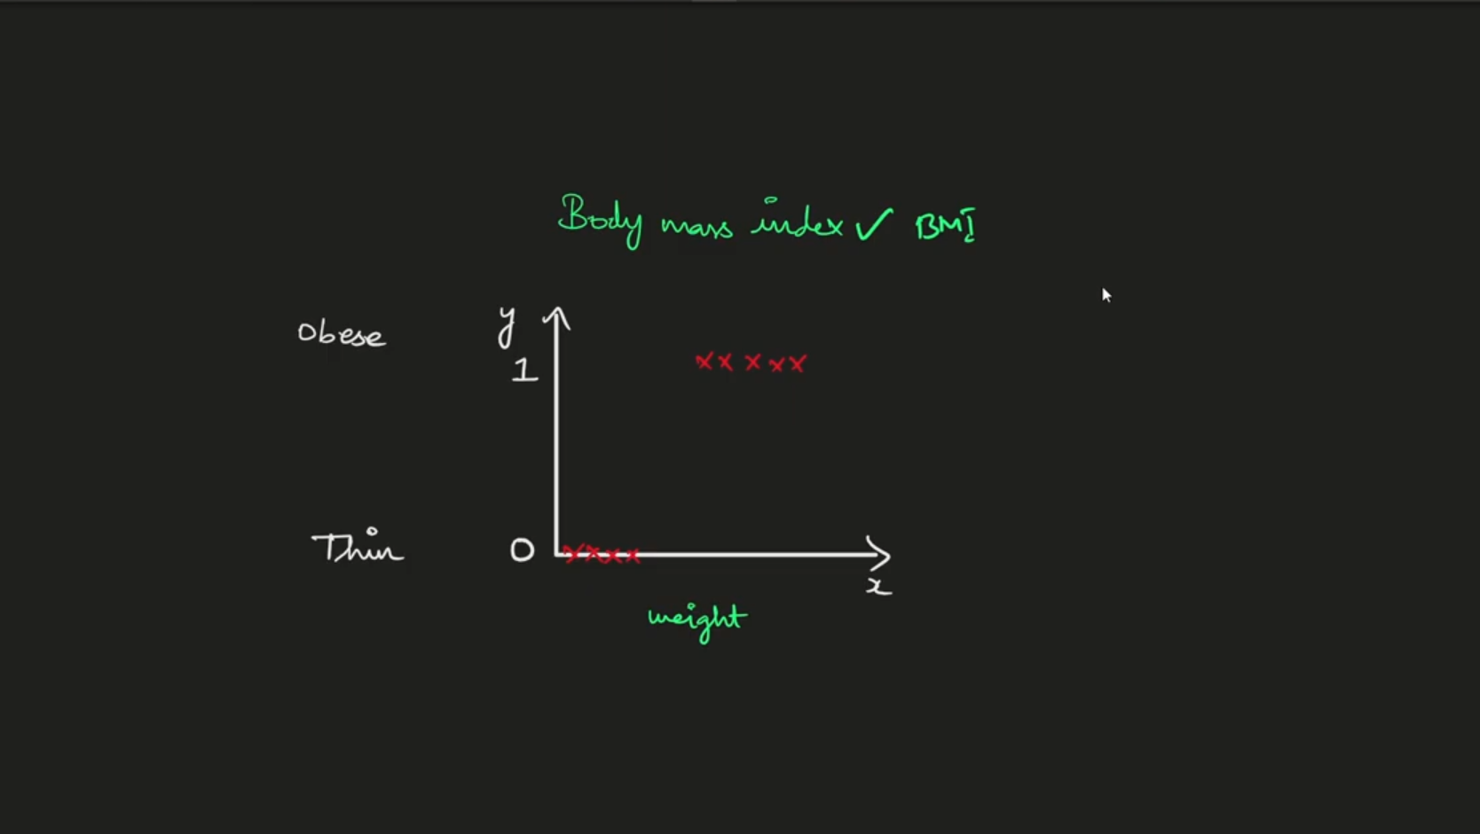

Slide 5
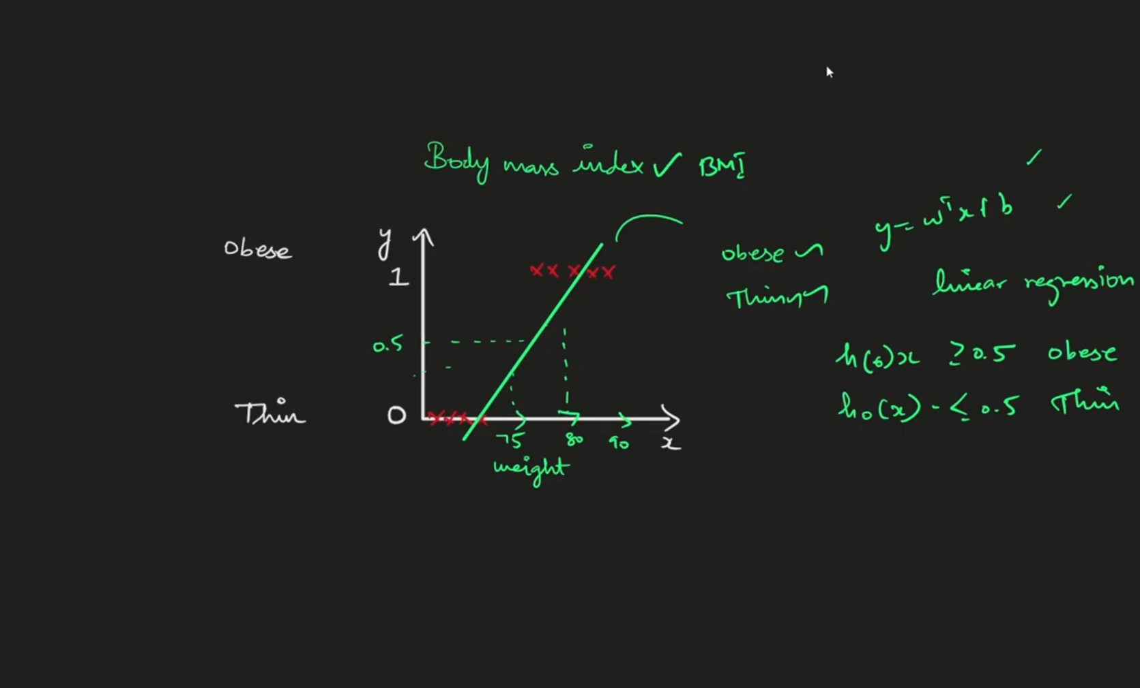

Slide 6
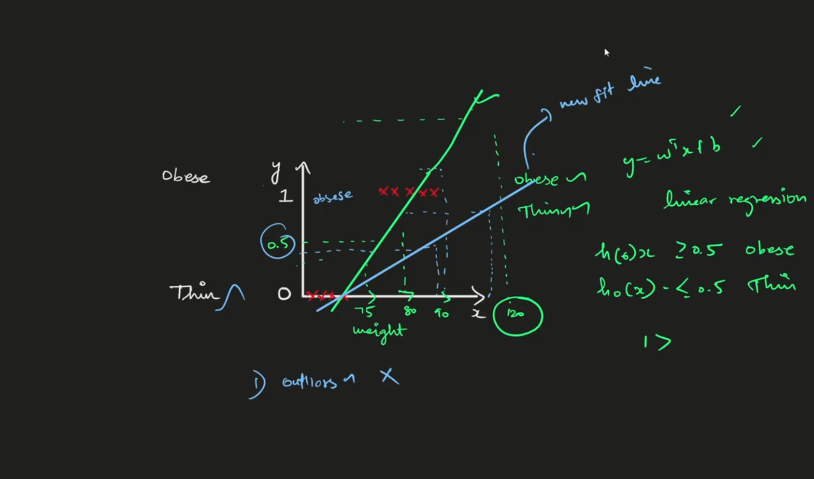

Slide 7
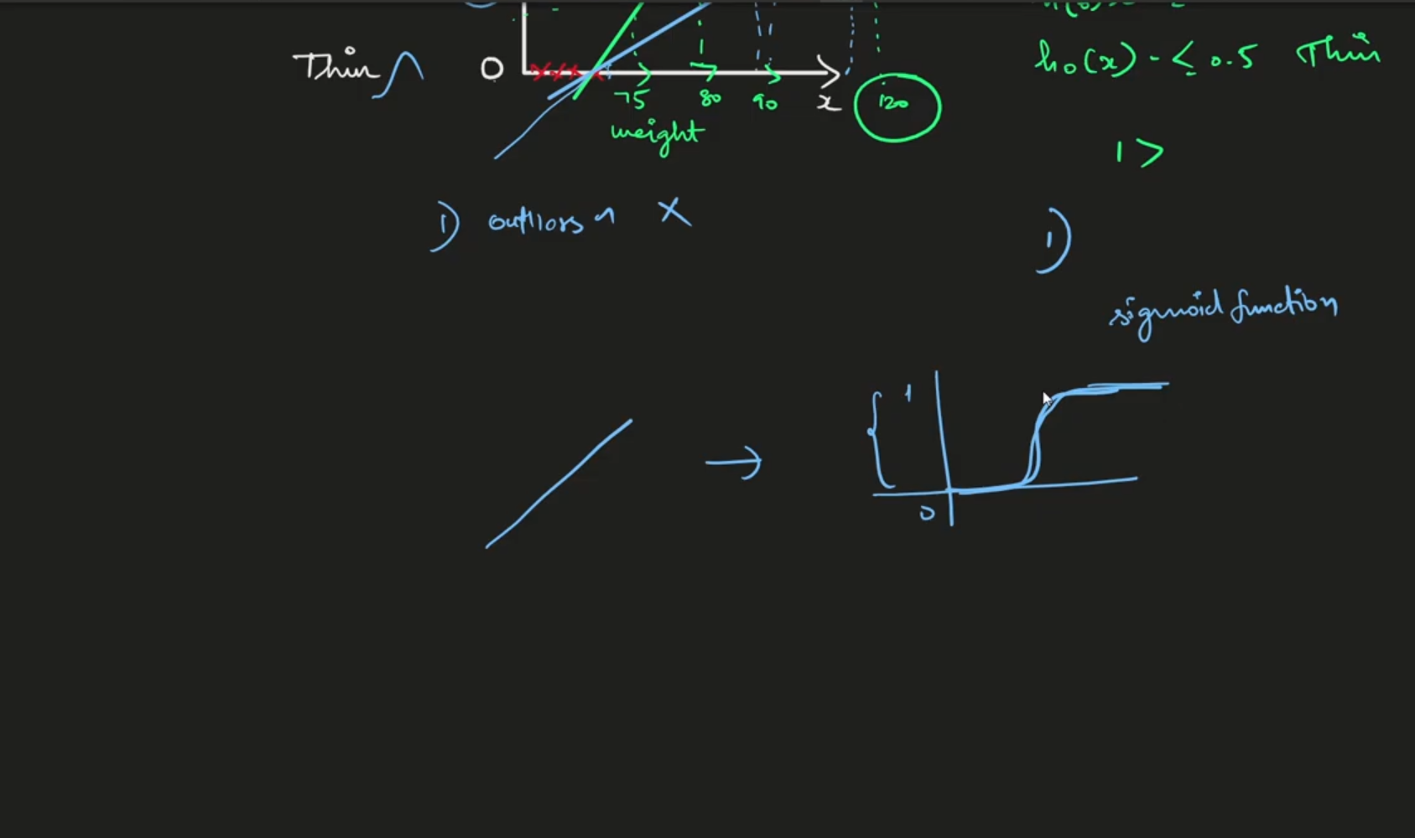

Slide 8
Logistic Regression Mathematical Intuition

Slide 9
In the last session we discussed about Why linear regression is not the best fit for classification problem
Thats the reason we got logistic regression algorithm to deal with those kind of classifications easily

Slide 10
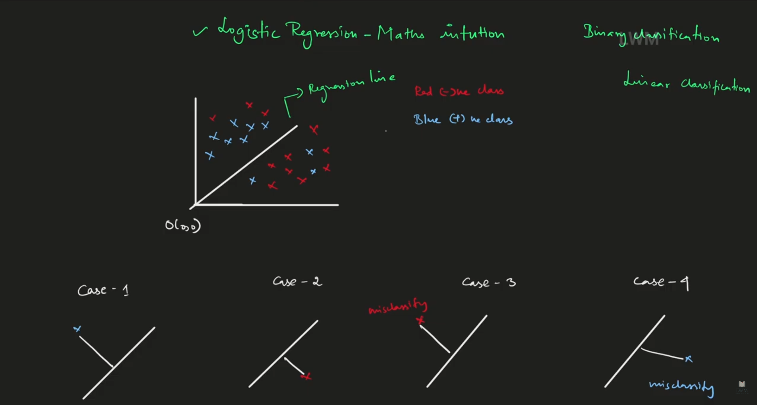

Slide 11
Diagram Explaination
In the above diagram the line is there regression line.
Along with you can see some data points, those are not said to be normal data points(Regression points) those are classification points
Data points are of 2 types
Positive class(Class 1) -> in that previous example positive values
Negative class(Class 0) -> in that previous example negative values
There is some points will go for mis classifications will be highlighted in the terms of cases
In that above example we took linear separable data and evaluated meanwhile whatever the problem we solved is classification problem

Slide 12
In linear regression model, if you want to go for best fit fine for the regression line we take residuals as an major component and we go for calculation
But in logical regression -> the best fit line is based on the co efficient of the omega in the formula
ω^{T} -> slope
X data points as classification
Y -> Output
In the equation, the regression line exist in origin so b(intercept) becomes 0. so formula become modified as
ω^{T}x + 0
ω^{T}x

Slide 13
Things to remember
Y = ω^{T}x -> it’s the distance between the point x and the plane
Regression line above values makes Slope those values are positive
Regression line above values makes Slope those values are negative
If the values are positive the y becomes yi = +ve = +1
If the values are positive the y becomes yi = +ve = +1

Slide 14
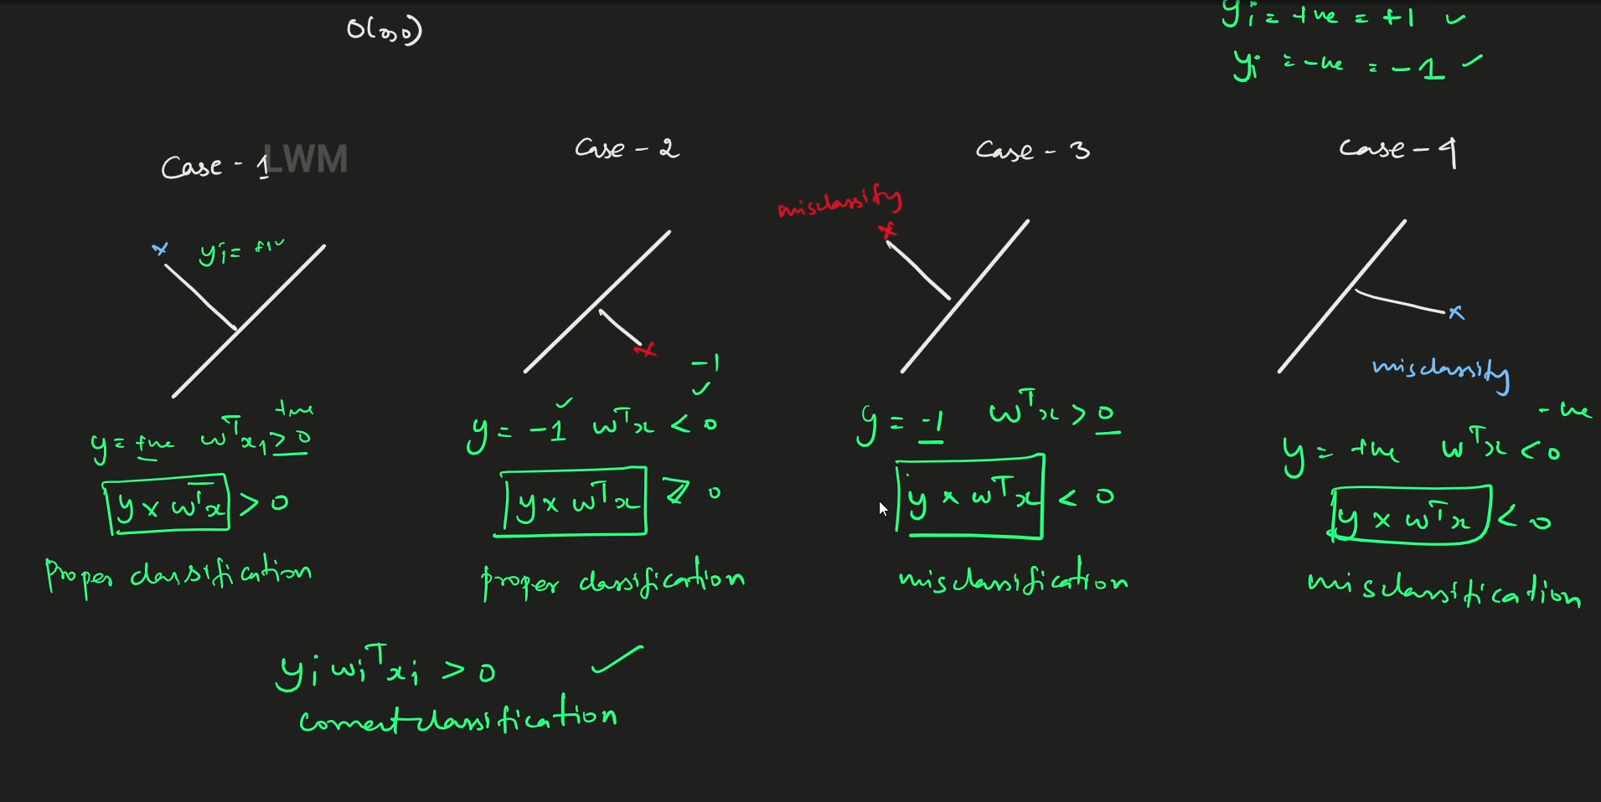

Slide 15
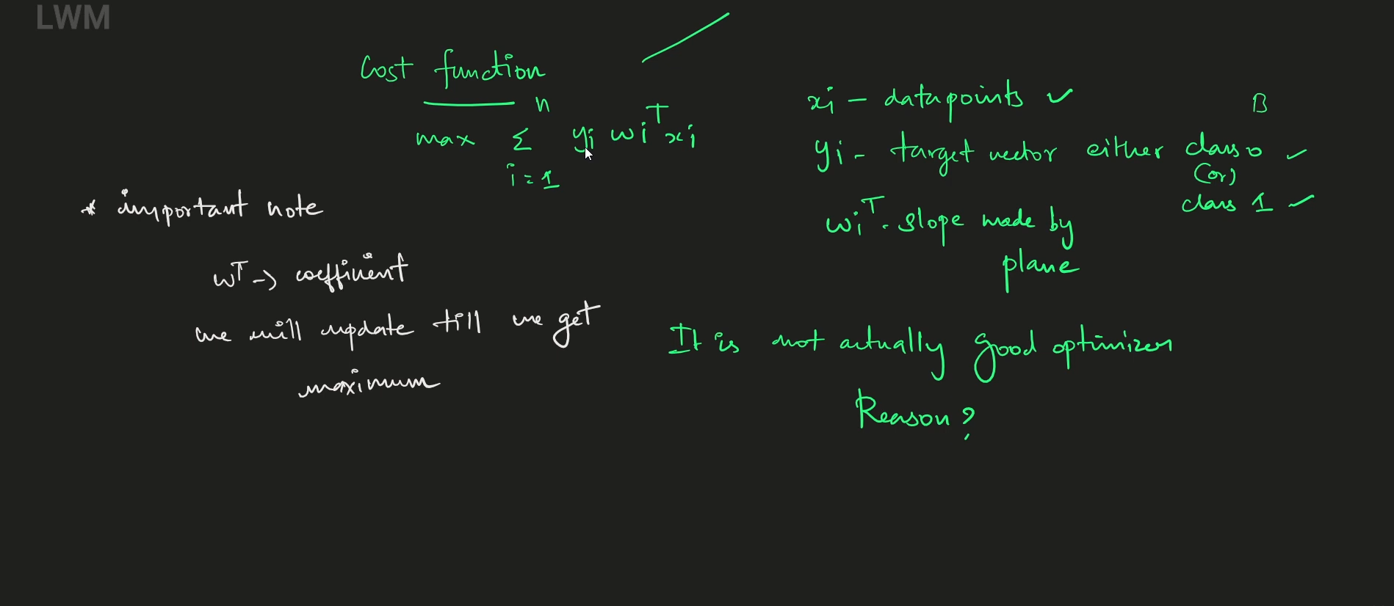

Slide 16
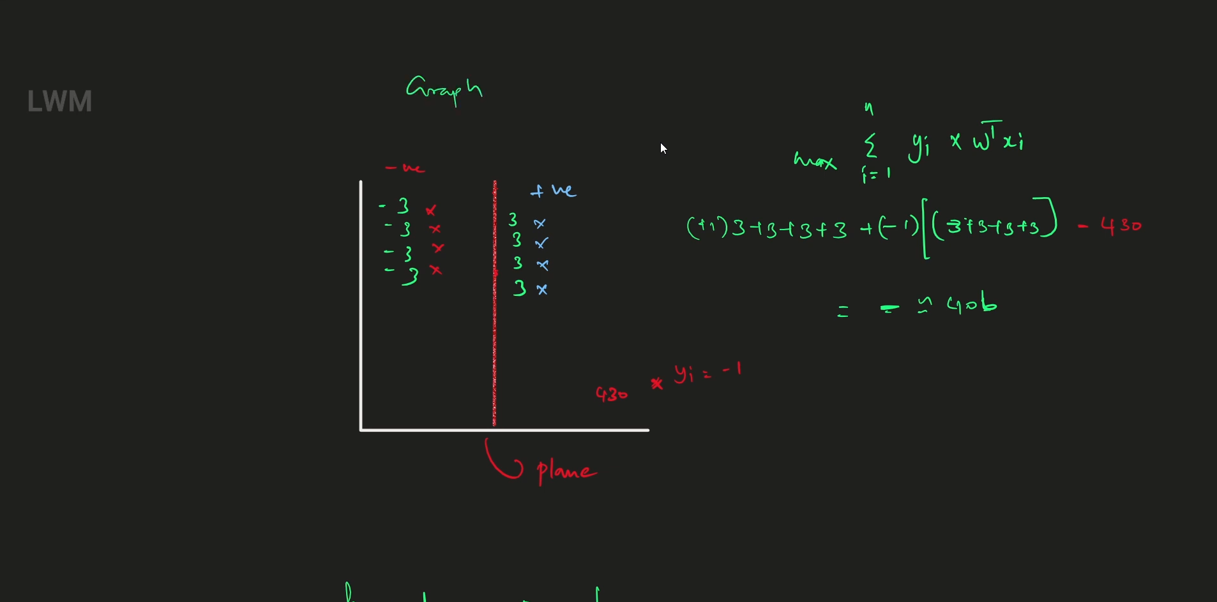

Slide 17
